Slide 1
SALES DATASET ANALYSIS-ADVANCED EXCEL PROJECT
Presented By:
K . Chandrika
Data Science & Analytics

Slide 2
Project overview & objectives
Project objectives:
To analyze sales data to identify trends, understand sales performance, and provide actionable business insights.
Goals:
o Analyze sales trends over time.
o Identify high-performing products and sales channels.
o Determine the impact of returns and discounts.
o Create a dynamic dashboard with key metrics.

Slide 3
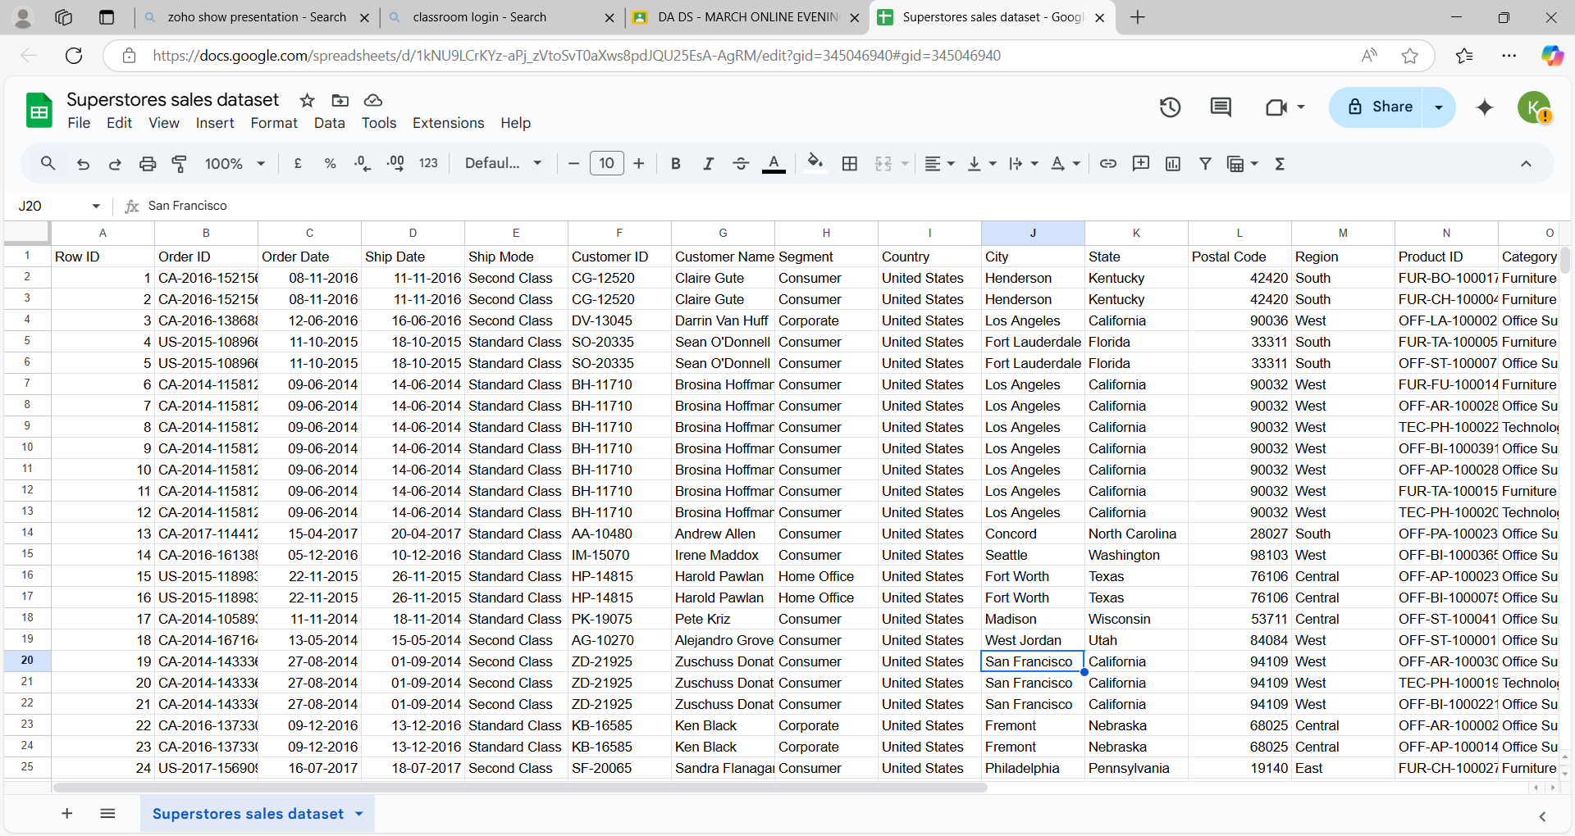
Data cleaning & preparation

Slide 4
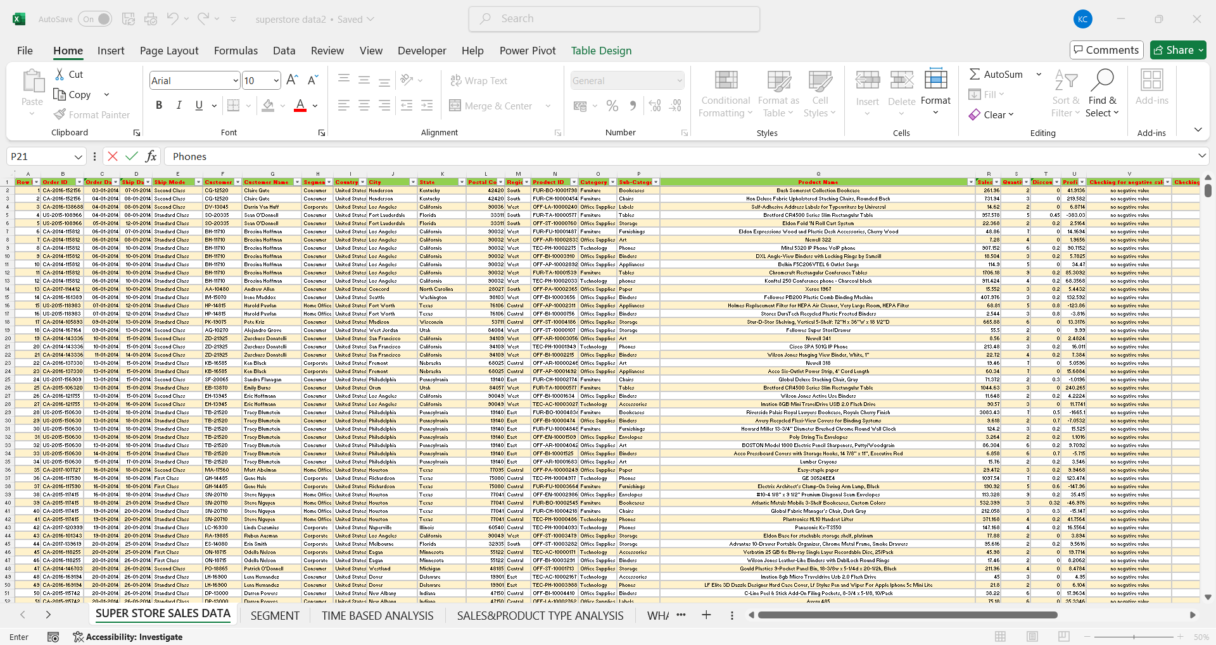
Cleaning data

Slide 5
Key metrics calculation and data analysis
Total Revenue:
formula=SUMPRODUCT(R:R, 1-T:T)
Average order value:
formula=AB/COUNTA(R:R)
Total Discount:
formula=SUMPRODUCT(R:R, T:T)

Slide 6
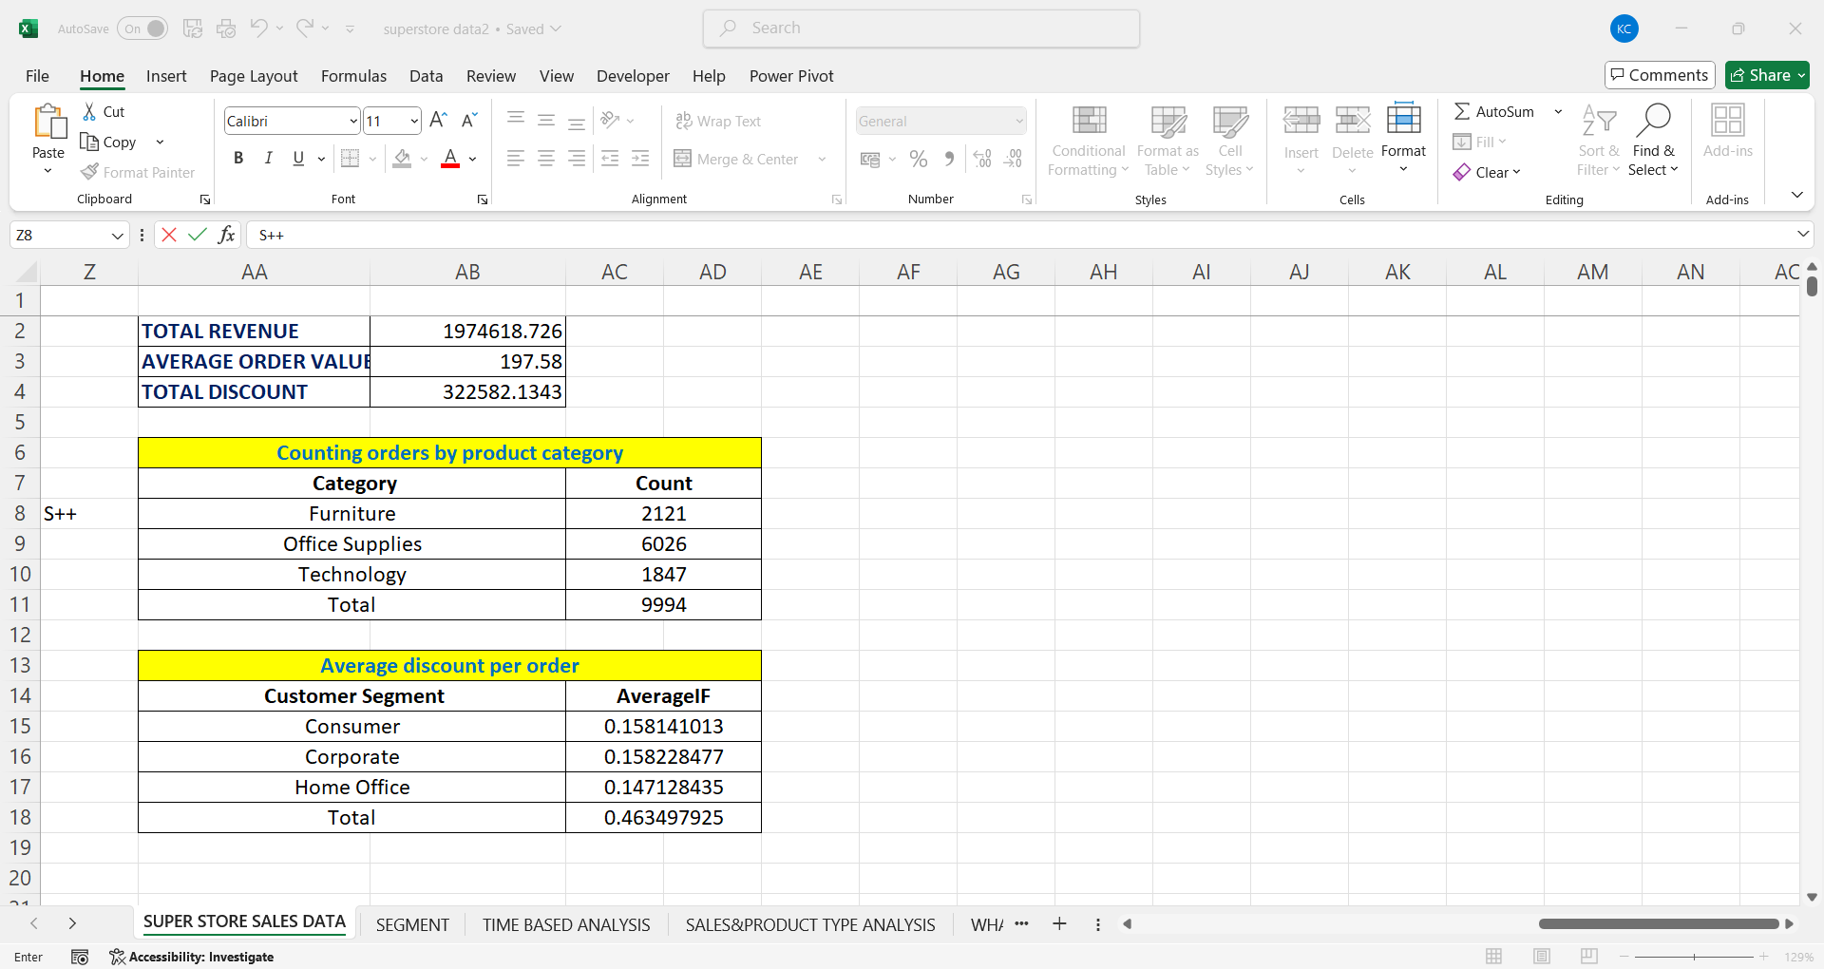
calculations

Slide 7
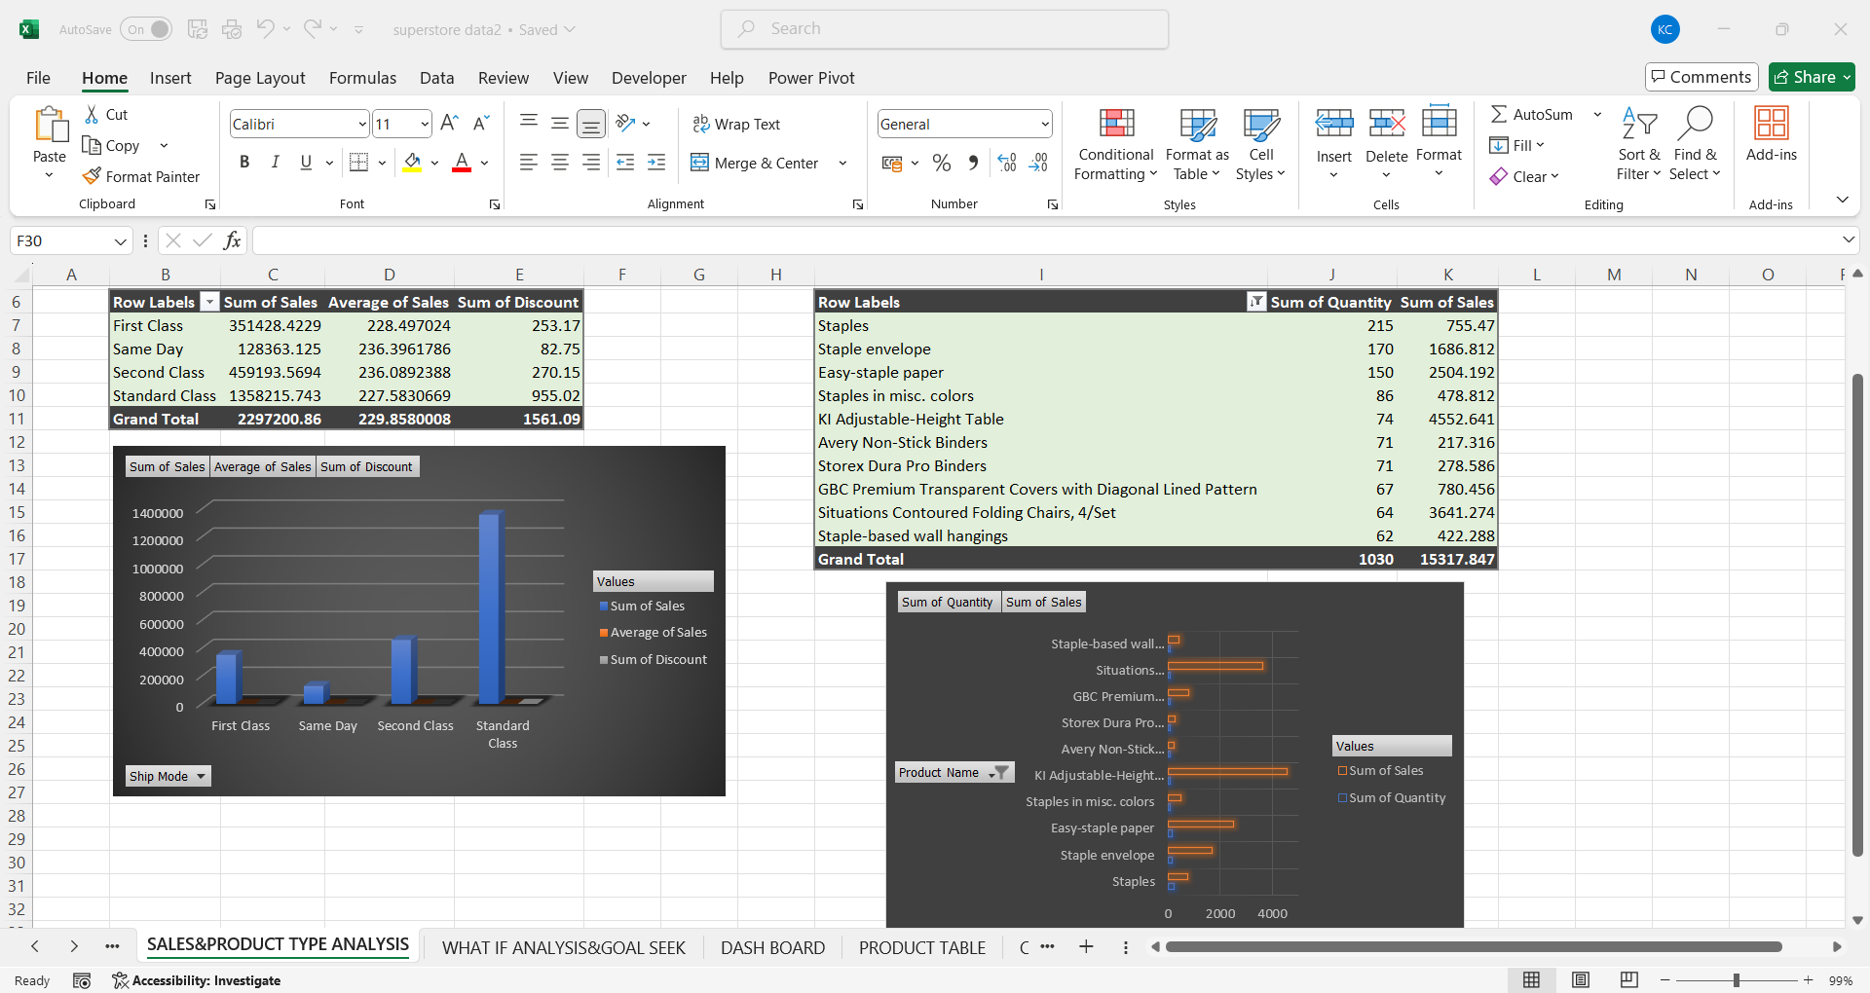
Pivot tables & charts
Pivot table:
PivotTables to aggregate data by dimensions like sales channel, product type, or date.
Pivot chart:
Pivot Charts were used to visualize sales trends over time or by product type.

Slide 8

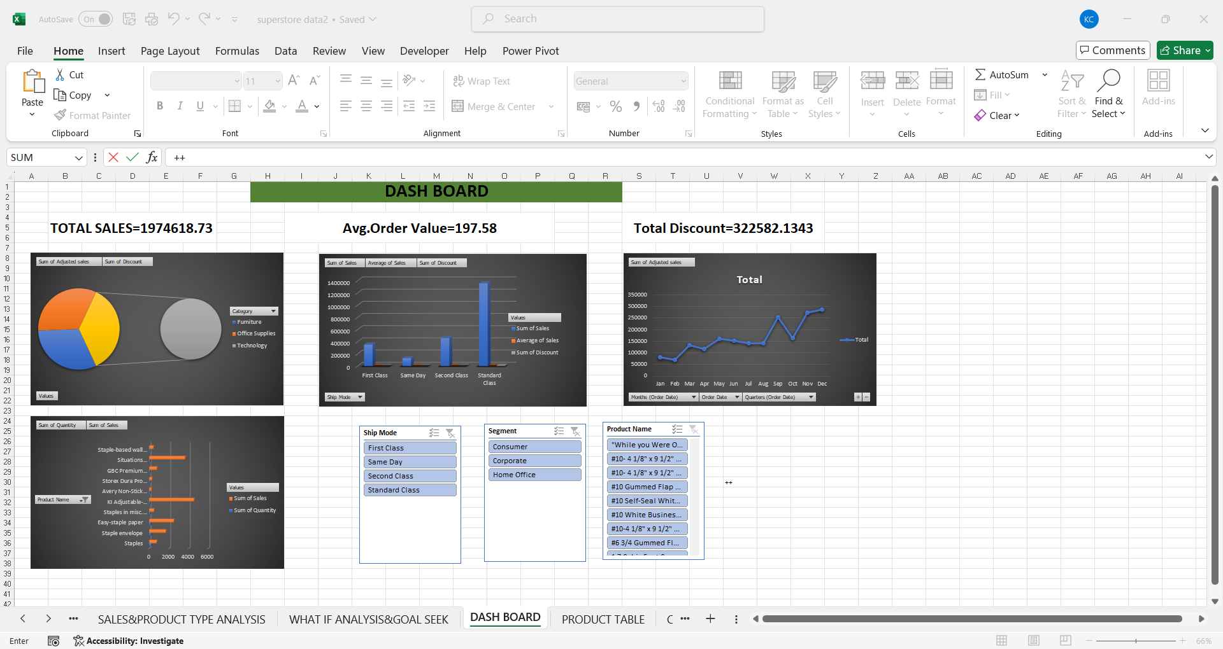
Dash board overview
Why we are use the dash board ?
1.Summarizes key data
2.Tracks performance
3.Supports faster decisions
4.Saves time

Slide 9
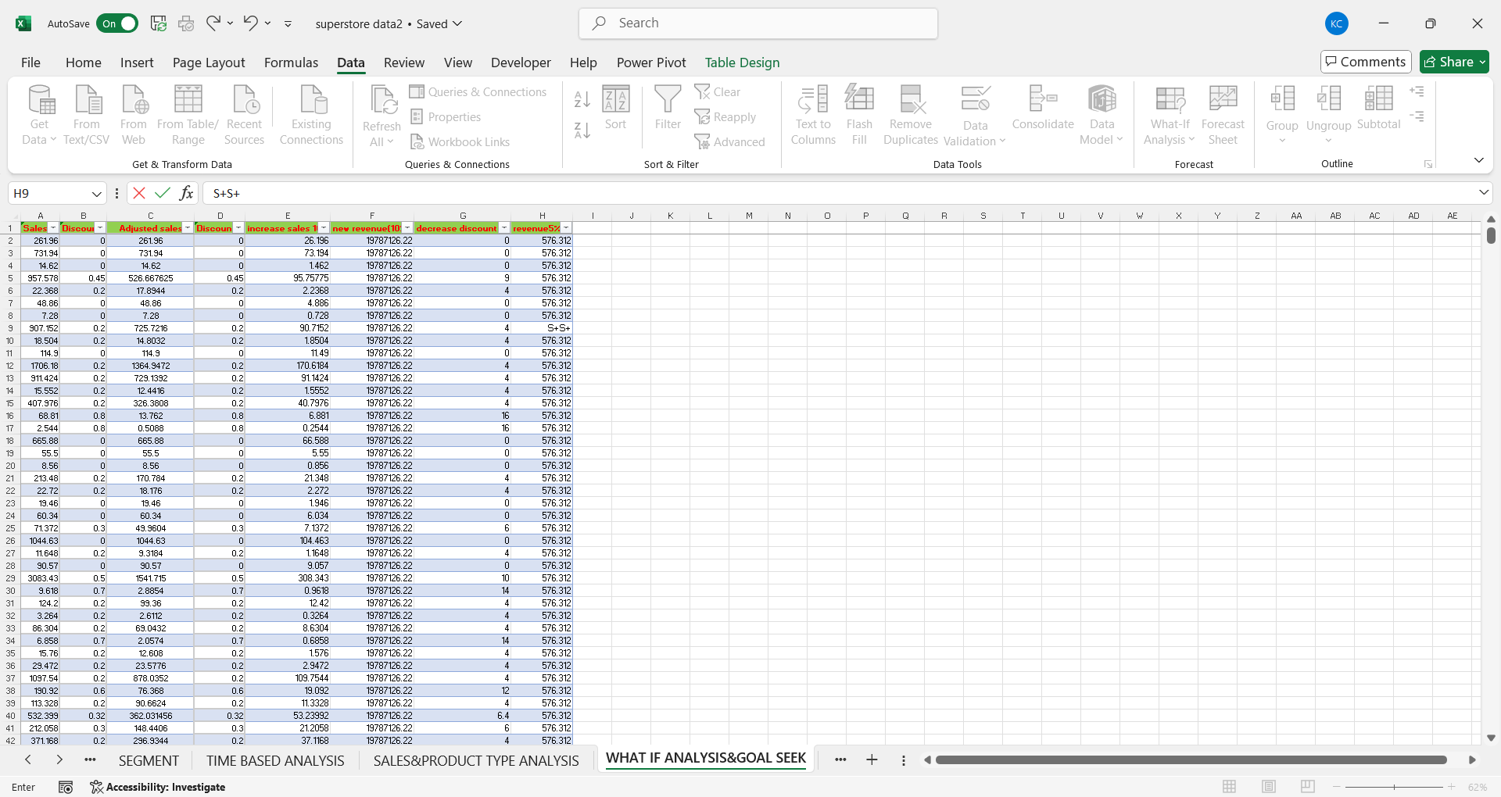
What-if analysis
Scenario:
To see how changes in factors (like sales volume or return rate) affect total revenue.
Goal seek:
To find the input value needed to reach a specific goal.

Slide 10
Macro recording
Formatting the sales table (e.g., bold headers, apply borders, change font colors)
Calculating total revenue automatically
Updating charts when data changes
Automation benefits:
Time saved
Consistency
productivity

Slide 11
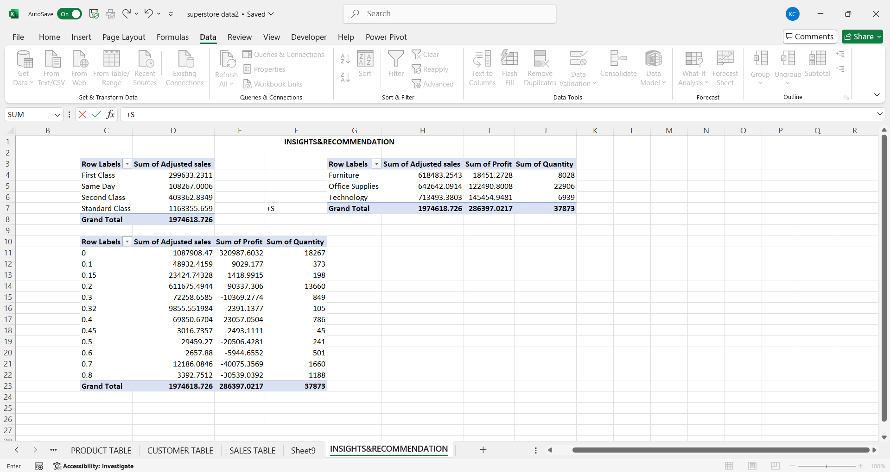
Insights & recommendation
1.Best-performing sales channels/products.
2.Trends in discounting and its impact on total sales.
3.Seasonal sales variations or peak performance times.
4.Recommendations for improving sales based on analysis (e.g., reduce returns, increase discounts on underperforming products).

Slide 12
CONCLUSION
The analysis of Superstore sales data provided valuable insights into the company's sales performance, customer behavior, and operational efficiency.

Slide 13
Thank you

